Slide 1
Getting those pesky values for destabilizing mutations
Kelly Brock
Takeda Group Meeting 2/12/2016

Slide 2
Reminder of projects
Need to computationally predict ddG values
  To develop tool for NGS to screen relevant missense mutations
Understanding how fitness landscapes contribute to overall heterogeneity in chromosome counts in CIN lines

Slide 3
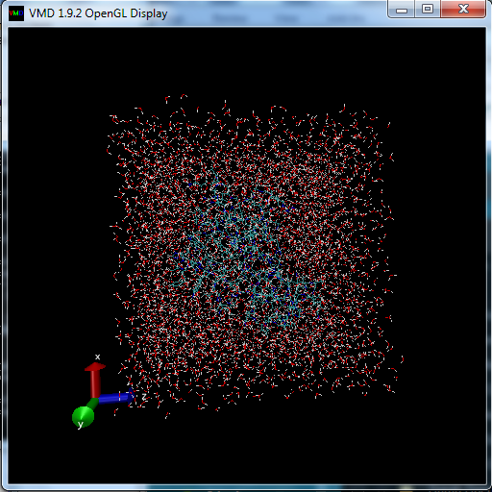
Changing boundary condition for solvation after crash

Slide 4
Solvation method could lead to additional need for user input
Have to change boundary conditions for each mutation
Error if solvation not large enough, but larger boxes take longer!
MAY DEPEND ON OVERALL STABILITY OF PROTEIN

Slide 5
Current status of MD simulations
Vacuum steps completed
Solvated component – larger solvation box has been running for ~5 hours on the equilibration

Slide 6
Can we exploit somebody else’s work?
SDM can predict ddG values based on not-publically-available “environment-specific substitution tables”
Miyazawa Jernigan 1994, Topham 1993, Topham 1997

Slide 7
Transitioning to CIN
Previously, used state-machine model to account for tetraploidy jumps
Is there anything interesting in the dynamics?

Slide 8
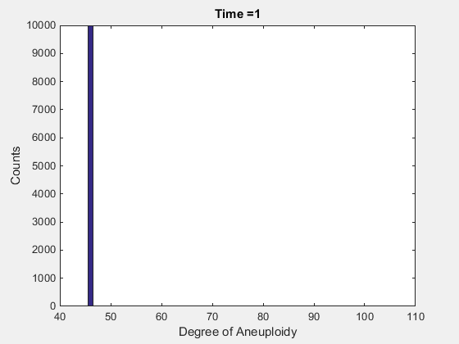
Jump to transition probability 0.2
(aka the return of the gifs)

Slide 9
Transition rate 0.5

Slide 10
Thoughts and next steps
Really high missegregation to get to peak near triploid in 500 gens
  “Sink” where we have our jump in transition probability, can we validate?
  Incorporating fitness into model

